Slide 1
Time & Attendance
How to Create a Manual Timesheet and Submit for Approval

Slide 2
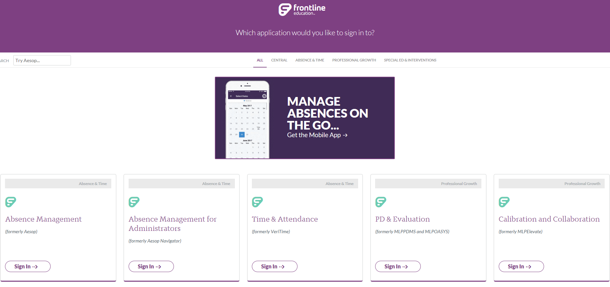
Go to Frontline’s Main Login Page & Select the Time & Attendance Portal
Click Here
https://frontlineeducation.com/SignIn

Slide 3
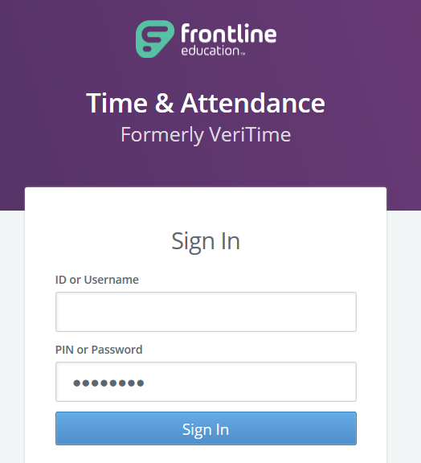
Log into Frontline’s Time & Attendance
Same Username and Password as Absence Management

Slide 4
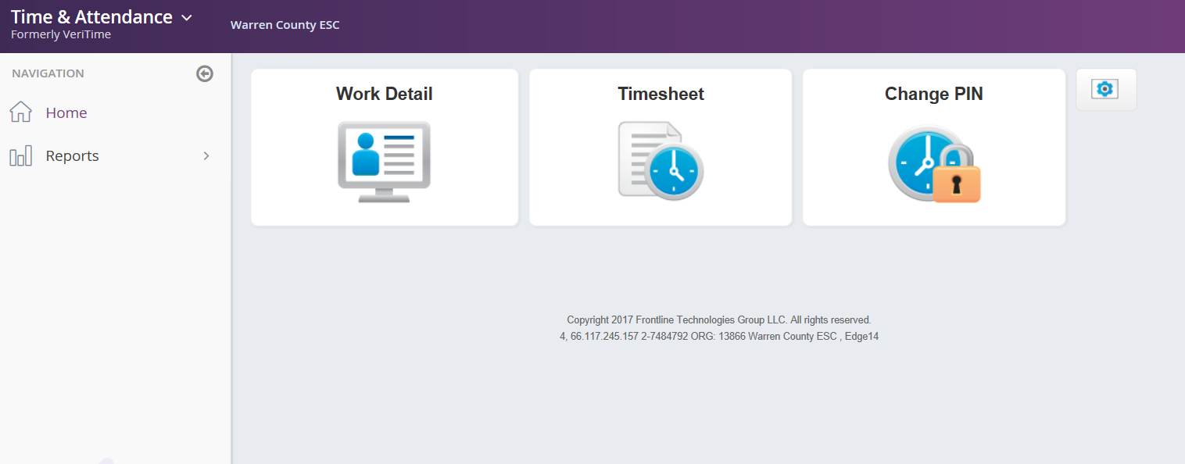
Select the Timesheet Icon to Begin Entering Time Worked
Click Here
The screen above is a view of the Time & Attendance Home page

Slide 5
Steps for Manually Entering Time
Click Actions Button
Choose Add Timesheets
Select the specific Date and Location/Job Type
Enter the In/Out time worked that day in quarter hour increments
Type Comments if needed (Optional)
Click “Save Changes” icon
Watch the Timesheet Video to see how this all looks in Frontline
Timesheet Video

Slide 6
Steps for Submitting Timesheets
Review daily time entered for accuracy
Review Weekly Summary for total hours worked
Click the blue “Submit” button
Select all the days to submit for approval and then click the “Continue” button
Type Comments if needed (Optional)
Click “Submit Timesheets”
Watch the Submit Timesheet Video to see how this all looks in Frontline
0
Submit Timesheet Video

Slide 7
QUESTIONS
?

Slide 8
REMINDER
Frontline Support is an excellent resource for answering most questions you have while using the Frontline software.

