Slide 1
Absence Management
How to Create a New Absence

Slide 2
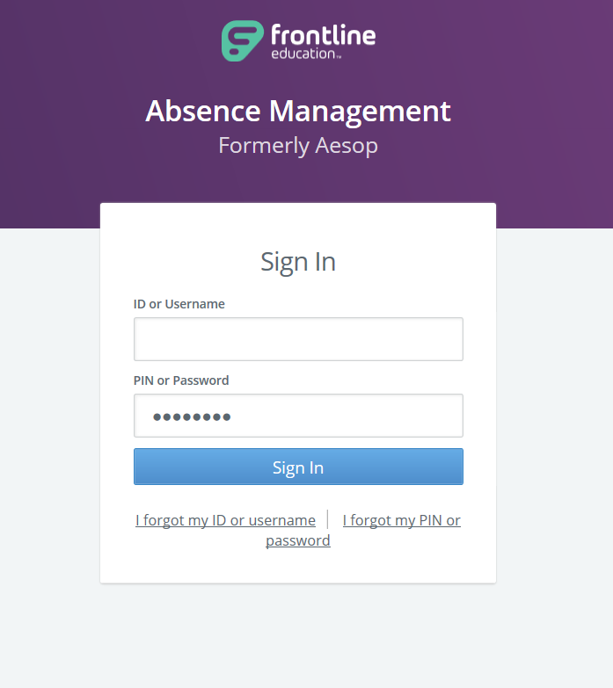
Log into Frontline’s Absence Management System
https://www.frontlineeducation.com/SignIn

Slide 3
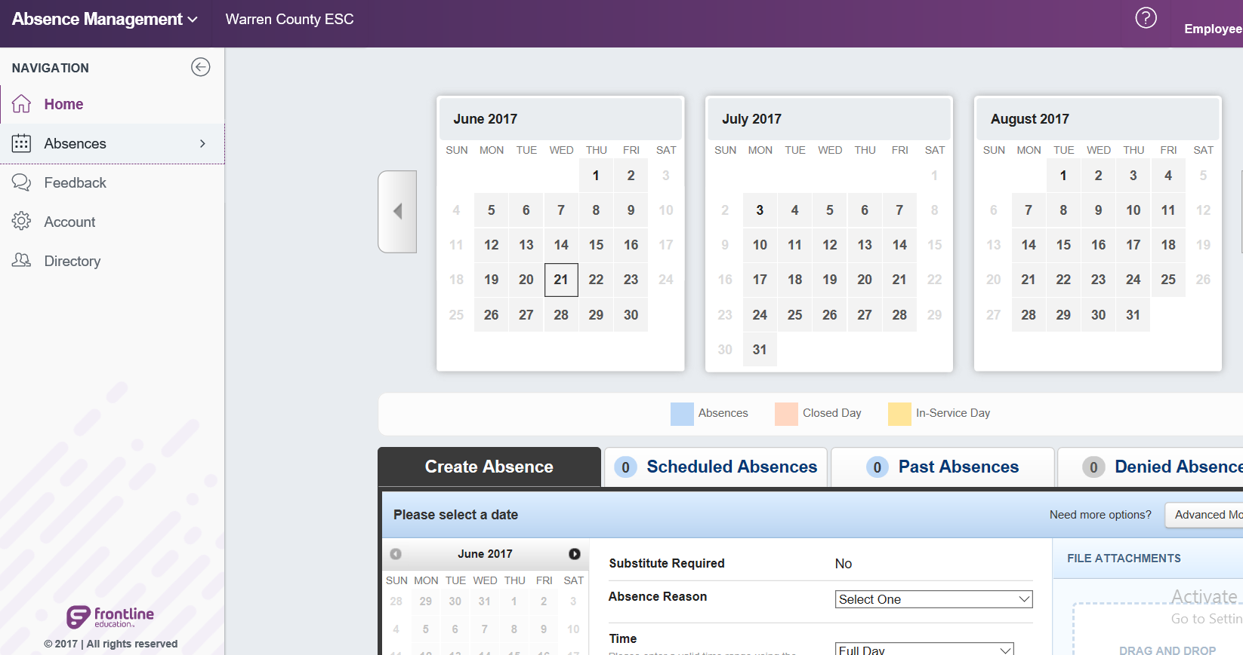
Create a New Absence
Click Here

Slide 4
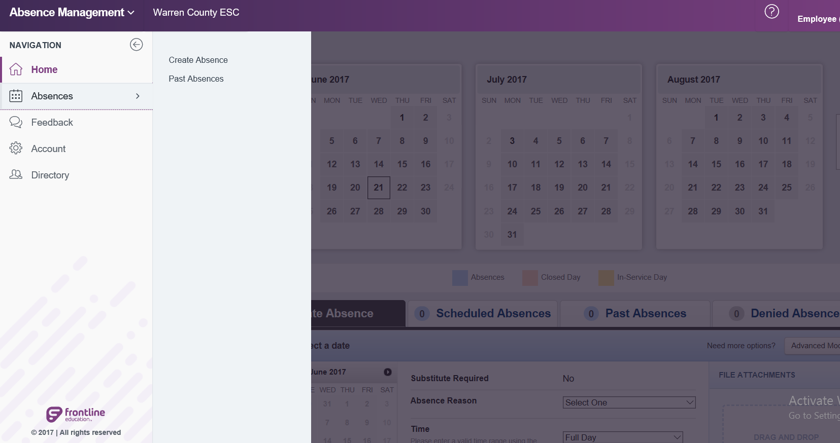
Create a New Absence
Click Here

Slide 5
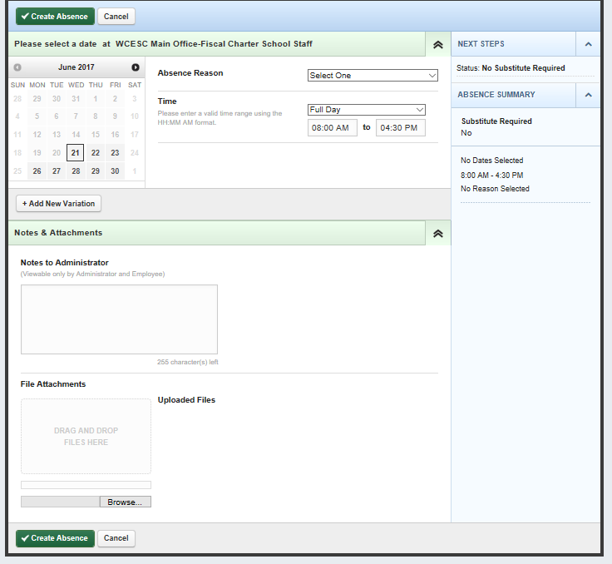
Enter the Absence Information
Select Date(s)
Chose Absence Reason
Select Time (Full Day, Half Day, or Custom)
Type any notes for Supervisor to see
Attach files if needed
Click on Create Absence
2
1
3
4
5
6

Slide 6
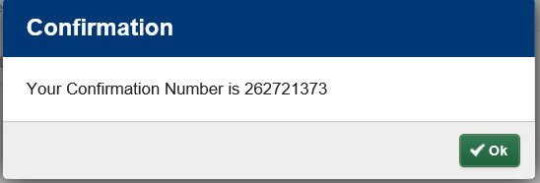
Absence Confirmation
After clicking “Create Absence”, you will receive a confirmation number to verify your request has been submitted successfully.

Slide 7
IMPORTANT UPDATE
All absence requests must be submitted on or prior to the day of the actual absence.
Frontline does not allow employees to enter absences after the occurrence happens.

Slide 8
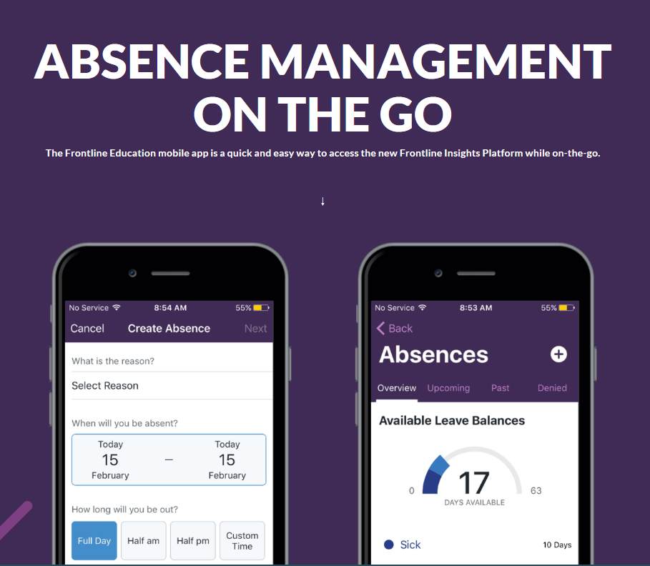
Absence Management App
Download the Frontline App to create absences and review balances from your smart phone!
REMINDER: You will need a one-time code to activate the Frontline App
APP CODE: 7354

Slide 9
REMINDER
Frontline Support is an excellent resource for answering most questions you have while using the Frontline software.

